Slide 1
FE FOUNDATION COURSE · PROFESSIONAL AUTHENTIC CONTEXT LEARNING
Who Am I
as a Teacher?
An eight-week journey through shadowing, service, and ethical reflection at Munsang College Primary Section.
PRESENTER
FIELD SITE · MENTOR
DURATION
ZHENG AIYU
Munsang College Primary Section
10 minutes
BA&BEd(EL) (Primary English) · 11533739
Mentor: Lee Kwan Leong · 2026.1.28 — 2026.3.27
Notes:
Good morning. I'm Zheng Aiyu, a BEd Primary English student. Over the next ten minutes I want to share what eight weeks of shadowing and service at Munsang College Primary Section have taught me about the question on this slide — who am I, as a teacher, after stepping into a real classroom?

Slide 2
THE QUESTION · WHY THIS MATTERS
"Who am I
as a teacher?"
Pre-service training gave me theory — TBLT, phonics, differentiated instruction, classroom management. The Foundation Course asked me to test that theory inside a real Hong Kong primary school, and to come back with an answer to one quietly demanding question: not what I have learnt, but who I am becoming.
Identity, not curriculum, is the deepest learning outcome of authentic context learning.
02 / 14
Notes:
Today's question is not just rhetorical. The course asked me to test theory inside a real primary classroom and to come back with an honest answer about who I am becoming. Identity, not curriculum, is the deepest learning outcome of authentic context learning. The next 12 slides walk through how I tried to answer it.

Slide 3
01 · THE FRAMING
A single question — three lenses.
A single question — three lenses.
Eight weeks at Munsang College Primary Section asked me to look honestly at my own teacher identity, through three converging lenses.
LENS 01
LENS 02
LENS 03
COTAP framework
Mentor's wisdom
Service evidence
The three professional roles set for Hong Kong teachers — a public, shared standard against which I audited myself.
Six weeks of shadowing a serving primary English teacher: time-stamped observation, structured interviews, lived practice.
Ten hours of TA, small-group tutoring and ECA — what worked, what didn't, what needed redesigning.
16 h shadowing · 10 h service · 26 h total · 10 forms signed · P.4 / P.5 / Drama Club / English Day
Notes:
[SLIDE 2 · ~40s]
Professional Authentic Context Learning gave me twenty-six hours in a real primary classroom — sixteen hours shadowing my mentor, and ten hours of school service. Three lenses guided my reflection. The first was the COTAP framework — Hong Kong's three professional roles, a public standard I could audit myself against. The second was my mentor's lived wisdom, captured through structured shadowing and a long interview on identity and ethics. The third was the concrete evidence I collected day after day, in P.4 and P.5 lessons, in small-group phonics tutoring, and in Drama Club rehearsals. What I want to share today is not a polished identity. It is a shift — the moment my picture of teaching changed.

Slide 4
COTAP SELF-AUDIT · WHO I CLAIMED TO BE
Three professional roles —
two strong, one open.
STRENGTH
STRENGTH
GROWTH AREA
01
02
03
Caring Cultivator
Inspirational Co-Constructor
Committed Role Model
of all-round growth
of professionalism
of knowledge
Tutoring evidence: emotional + academic support for marginalised learners.
Project-based learning, digital scaffolding, multimodal lesson design (Bruner, 1960).
Curriculum leadership, PLC facilitation, structured reflection — to develop deliberately.
I came in solid on the first two. The third was a question, not a claim.
04 / 14
Notes:
I audited myself against the three COTAP roles. Strong on Caring Cultivator — two years of voluntary tutoring sharpened that. Strong on Inspirational Co-Constructor — I plan student-centred lessons drawing on Bruner. But Committed Role Model? That was my growth area: curriculum leadership, professional learning community contribution, and structured reflective discipline. I came into block service knowing the third role was a question, not a claim.

Slide 5
A DAY IN THE LIFE · SHADOWING OBSERVATIONS
What I actually saw —
in the mentor's twelve-hour day.
07:55–08:20
Pre-lesson
Colour-coded core + challenge worksheets, panel-head consult on Reading Week.
08:20–08:40
Head teacher morning assembly
Uniform/diary check; private behaviour conversation rather than public reprimand.
08:40–09:20
P.4 reading lesson
Think–pair–share, gradual release (I do · we do · you do), gestures + visuals.
11:00–11:40
Marking + planning
Forty workbooks marked between recess and lunch — written feedback per pupil.
13:30–14:30
Service in action (mine)
TA support for two lower-achievers; phonics mini-task I wrote, mentor reused.
15:00–16:00
ECA · Reading Programme
After-school book club for newly-arrived pupils — pastoral & academic woven.
05 / 14
Notes:
Shadowing made the invisible visible. Pre-lesson colour-coded worksheets that protect lower-achievers' dignity. Pastoral conversations that are problem-focused, not person-focused. Forty workbooks marked between recess and lunch. The Reading Programme that turns book-time into pastoral time for newly-arrived pupils. Twelve hours that re-defined what 'teaching' means.

Slide 6
THE SHIFT · WHAT BROKE OPEN
I was wrong —
in an unexpectedly hopeful way.
FROM
Teaching = lesson delivery
Class management = control
Care = personality
TO
Teaching = environment design
Management = behaviour design
Care = professional skill
06 / 14
Notes:
A few weeks in, my assumptions cracked open. Teaching is not lesson delivery — it is environment design. Classroom management is not control — it is behaviour design. And care is not personality — it is a professional skill, learnable, structured, ethical. This shift reorganised everything I thought I knew.

Slide 7
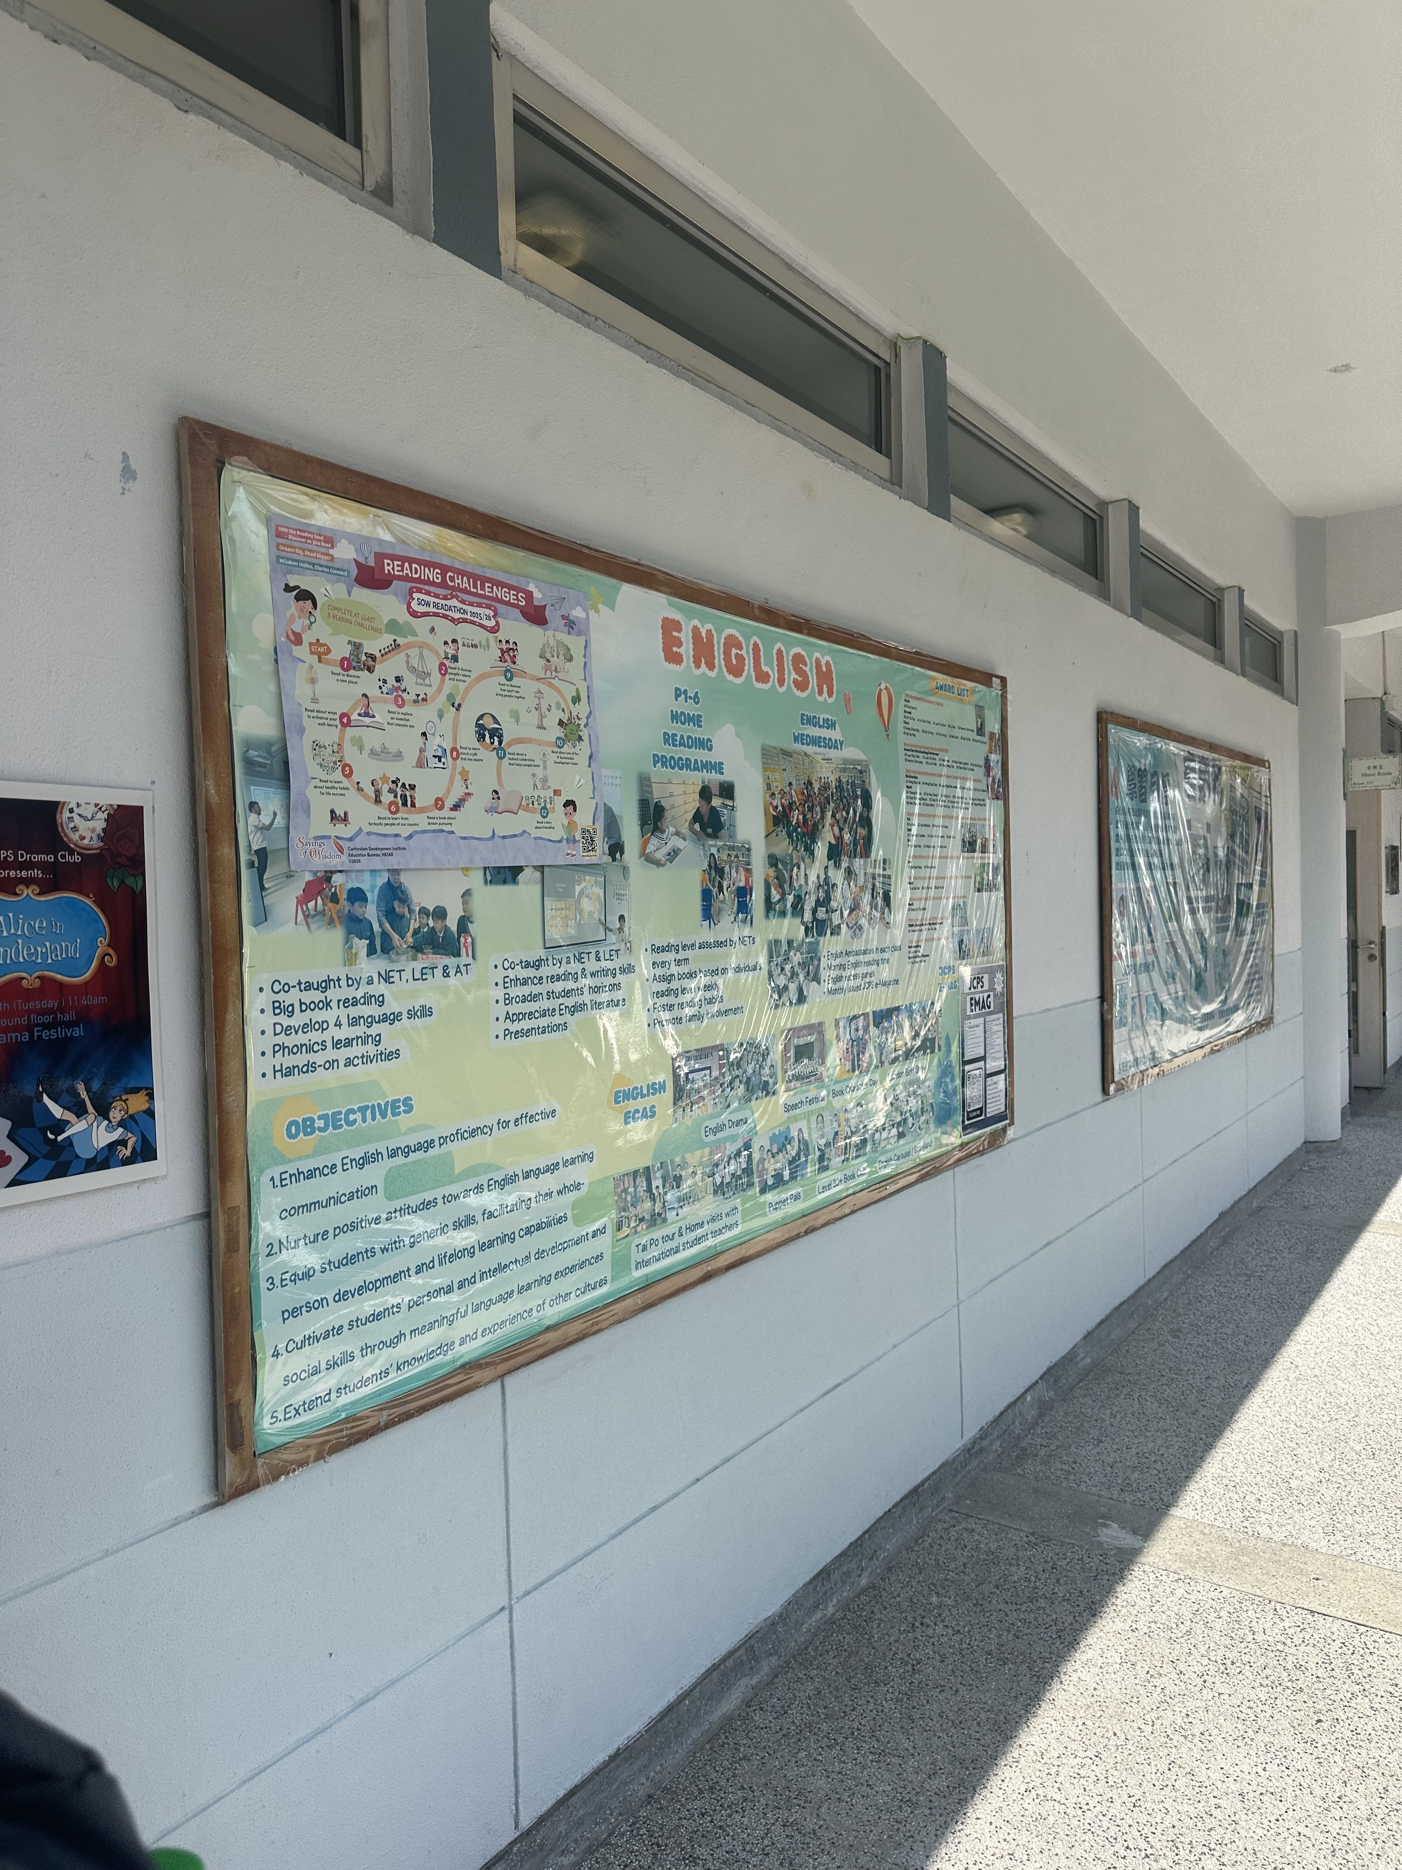
THE 4TH ROLE · A PROFESSIONAL ADDITION
From three teacher roles —
to the fourth I now claim.
MY MENTOR'S THREE CORE ROLES
Knowledge Transmitter
Moral Exemplar
Care-Giver
I ADD A FOURTH —
Designer of Learning Environments
(Bruner, 1960) — colour-coded worksheets, transition signals, deliberate seating, the English Reading Programme on the right. These are not decoration. They are pedagogy made visible.
EVIDENCE · Whole-school English Reading Programme
07 / 14
Notes:
My mentor's interview named three core roles — knowledge transmitter, moral exemplar, care-giver — and kept critical distance from gate-keeper and quasi-parent. I agree those three are foundational. But shadowing made me add a fourth: designer of learning environments, in Bruner's sense. The English Reading Programme bulletin on the right is exactly what I mean. Colour-coded worksheets, transition signals, deliberate seating — these are not decoration. They are pedagogy made visible.

Slide 8
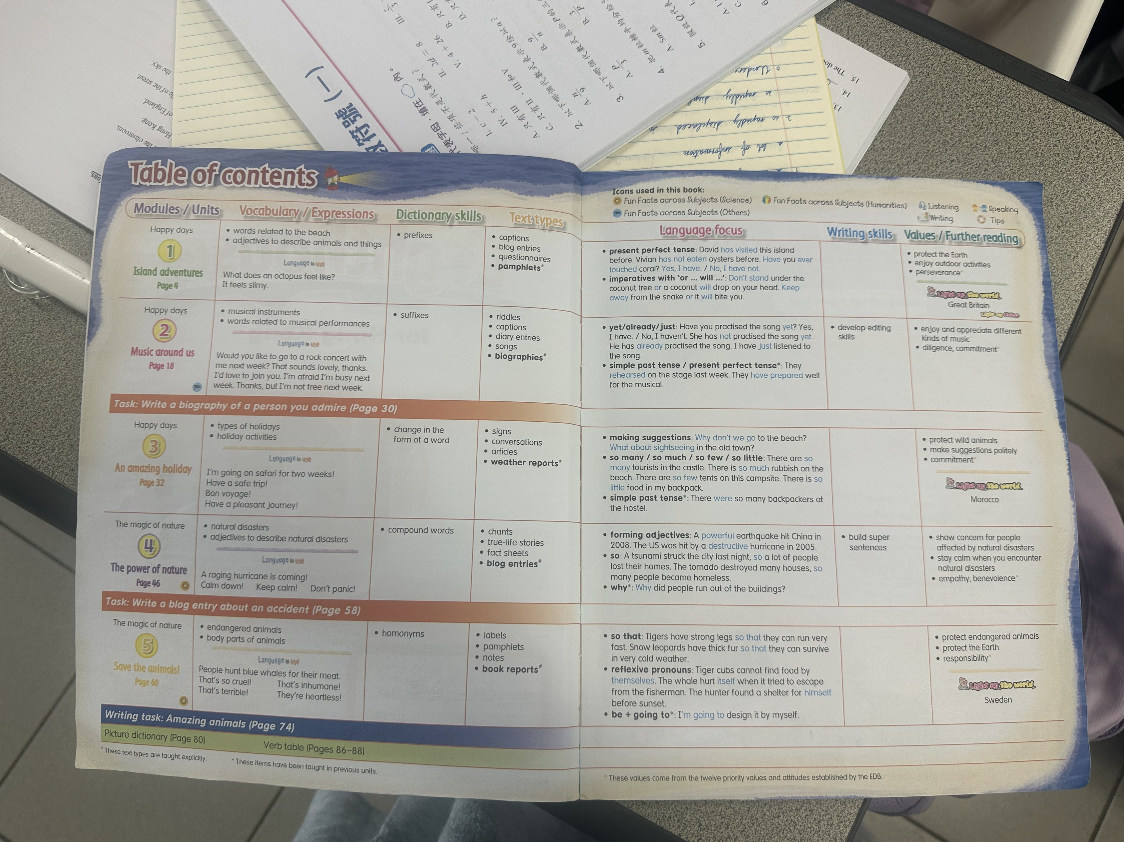
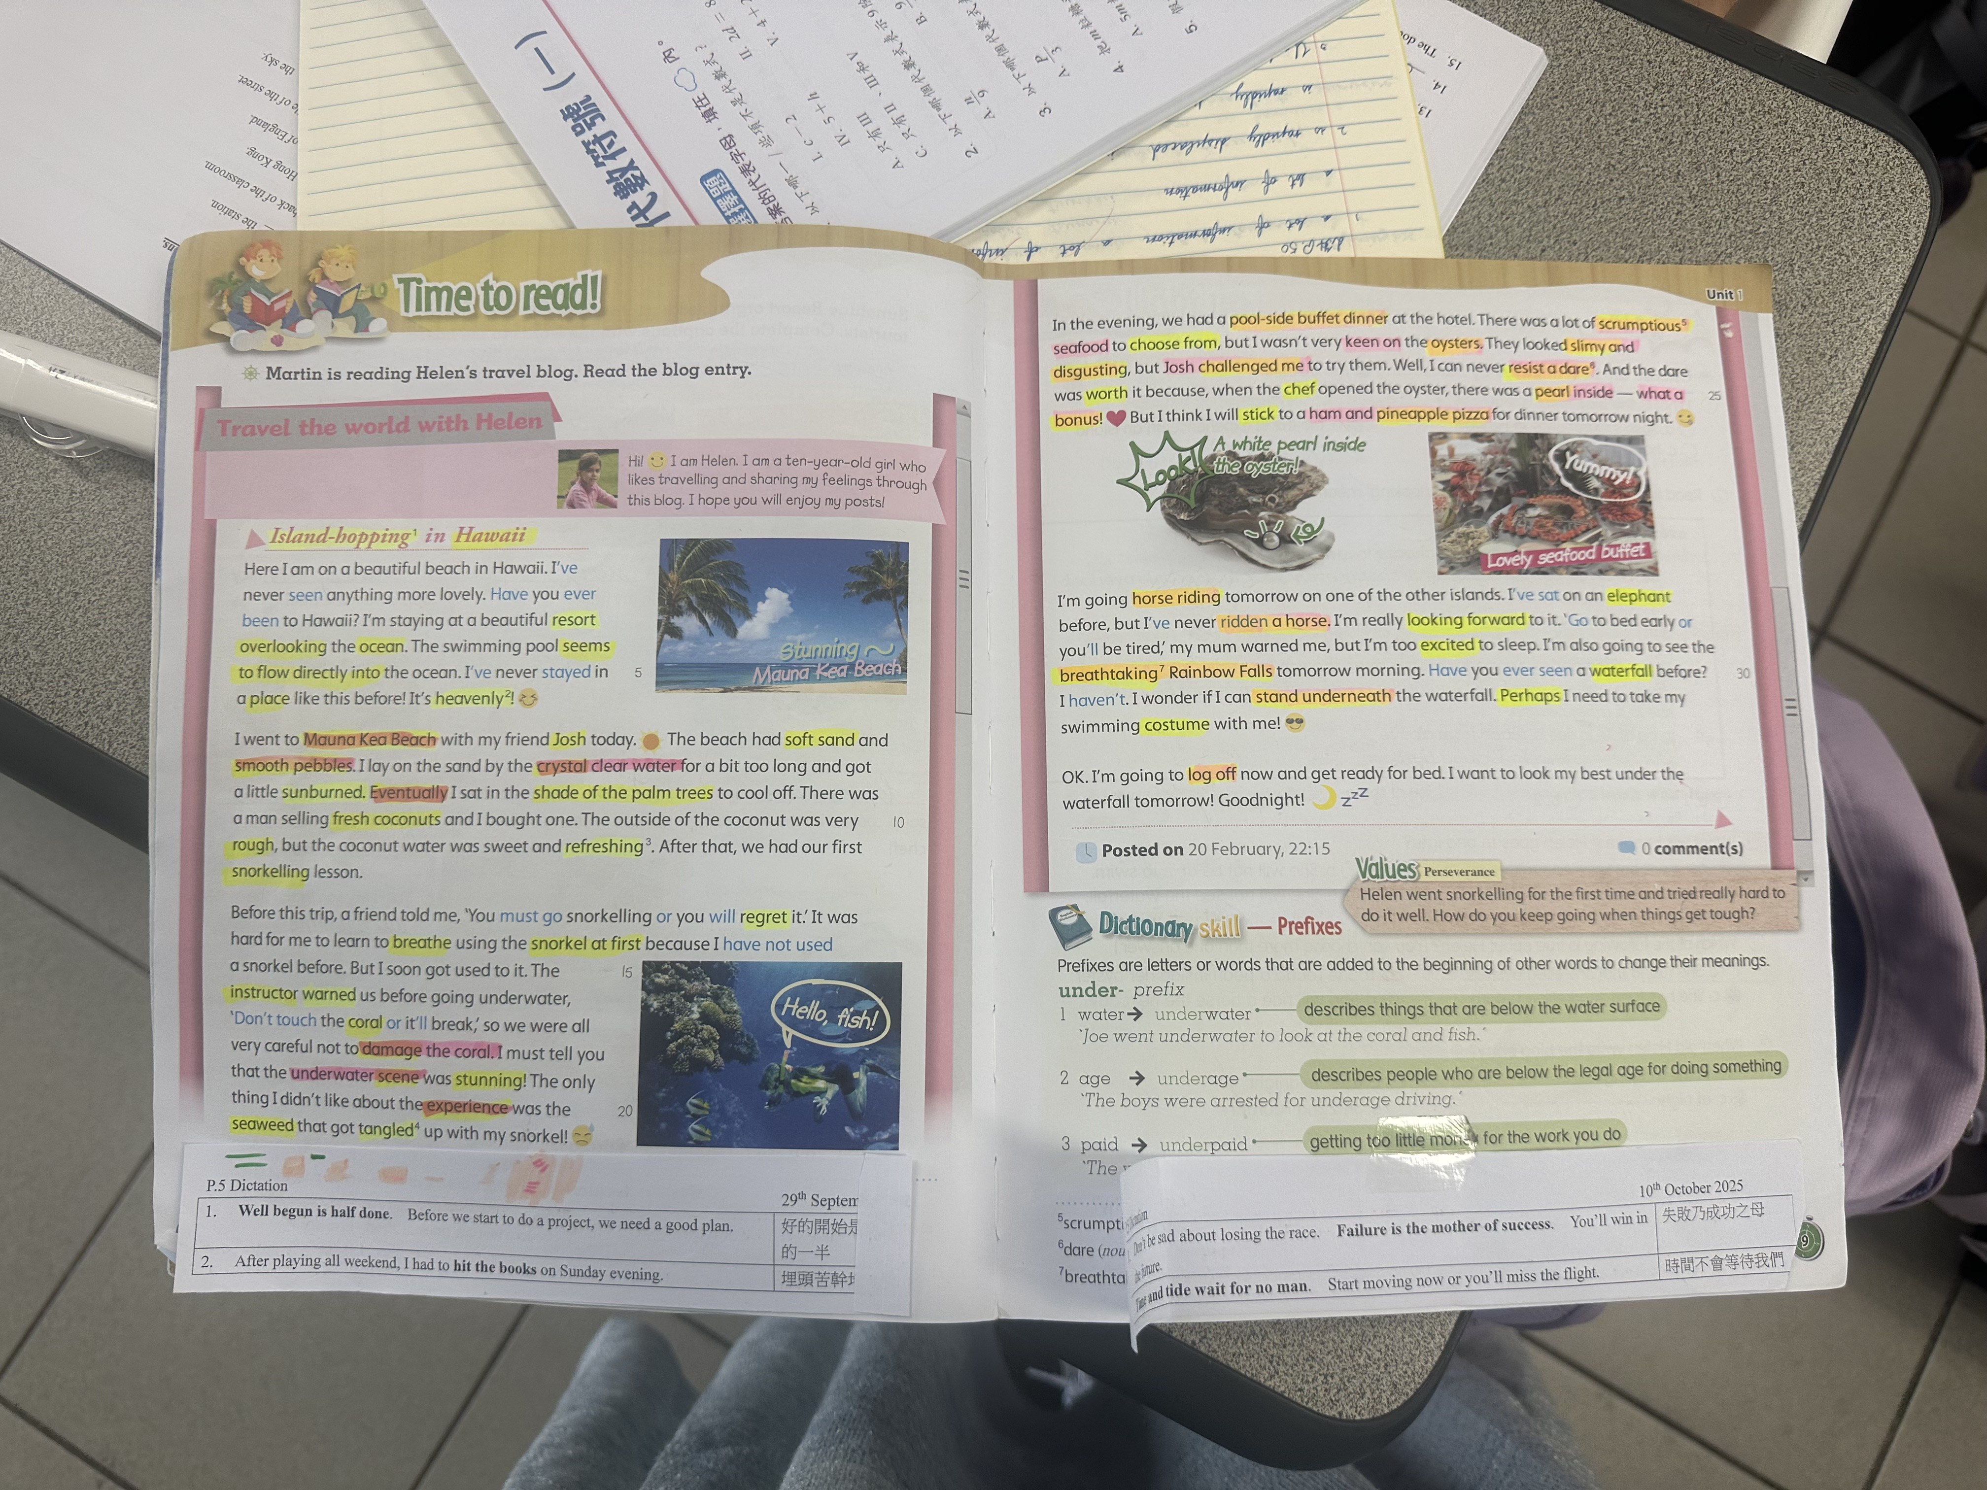
WHAT SERVICE TAUGHT ME · TA · TUTORING · ECA
Theory survives —
only when I make it specific.
SCAFFOLDING
I-do · We-do · You-do
Lower-achievers needed the 'we-do' phase to be longer, not louder. Pacing, not volume.
DIFFERENTIATION
Two versions — same dignity
Core + challenge worksheets, distributed without flagging the difference. Learnt this from my mentor.
Mentor's textbook — table of contents
PASTORAL CARE
Names before content
Address every pupil by name before delivering instruction. Forty pupils, forty greetings.
TECH RESTRAINT
Quizizz only when it earns its time
Digital tools serve learning. Rejected them when paper and pen worked better.
In-class reading — 'Time to read!' enrichment text
08 / 14
Notes:
Service taught me that theory only survives when I make it concrete. Scaffolding for lower-achievers means lengthening the we-do phase, not raising my voice. Differentiation means two worksheet versions distributed without flagging the difference — a small design choice that protects dignity. Pastoral care begins with knowing every pupil's name before I deliver any instruction. And technology serves learning; it does not replace it.

Slide 9
MENTOR'S ETHICAL COMPASS · WHAT I ENDORSE
Five compass points —
from her seven-question interview.
FAIRNESS
Equal weight to every pupil's voice.
CONFIDENTIALITY
Pastoral information stays where it belongs.
ASSESSMENT HONESTY
Marks describe learning, not pupil character.
PUPIL DIGNITY
Correction in private, recognition in public.
COMMITMENT
Every child — including the inconvenient ones.
09 / 14
Notes:
Her ethical compass came out across seven structured interview questions. Fairness — equal voice for every pupil. Confidentiality — pastoral information stays where it belongs. Assessment honesty — marks describe learning, not character. Pupil dignity — correction in private, recognition in public. Commitment — every child, including the inconvenient ones. I endorse all five. They are now mine to live up to.

Slide 10
MY ETHICAL EXTENSIONS · WHERE I RESPECTFULLY GROW HER COMPASS
Two additions —
for the Hong Kong AI-era classroom.
EQUITY > EQUAL TREATMENT
EPISTEMIC HONESTY
Beyond fairness
AI-era teacher virtue
Cochran-Smith (2004): structural inequities mean equal treatment is sometimes unequal in effect. Differentiated dignity, not uniform process.
When models can answer faster than us, intellectual humility — knowing the limits of my knowledge — becomes a moral skill students must see modelled.
There are moments when organisational protocols are inadequate, and moral courage demands bending them for the child's welfare.
10 / 14
Notes:
Two respectful extensions of my mentor's compass. First, equity beyond equal treatment — Cochran-Smith reminds us that structural inequities mean treating pupils identically can mean treating them unequally in effect. Second, epistemic honesty — when AI models can answer faster than I can, intellectual humility becomes a moral skill students need to see modelled. There are moments when organisational protocols are inadequate; moral courage then demands bending them for the child's welfare.

Slide 11
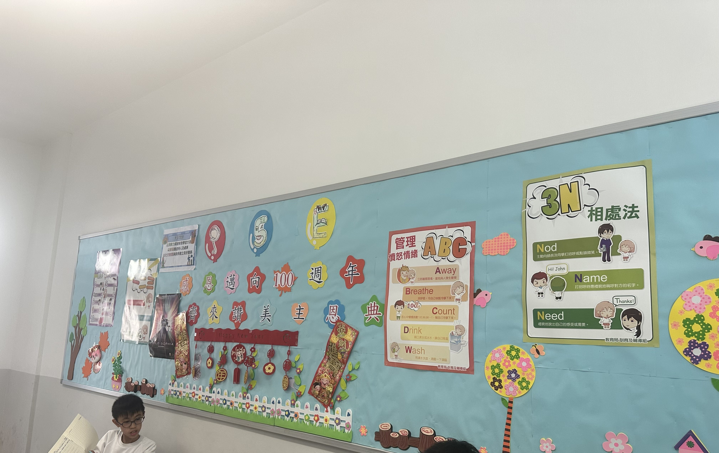
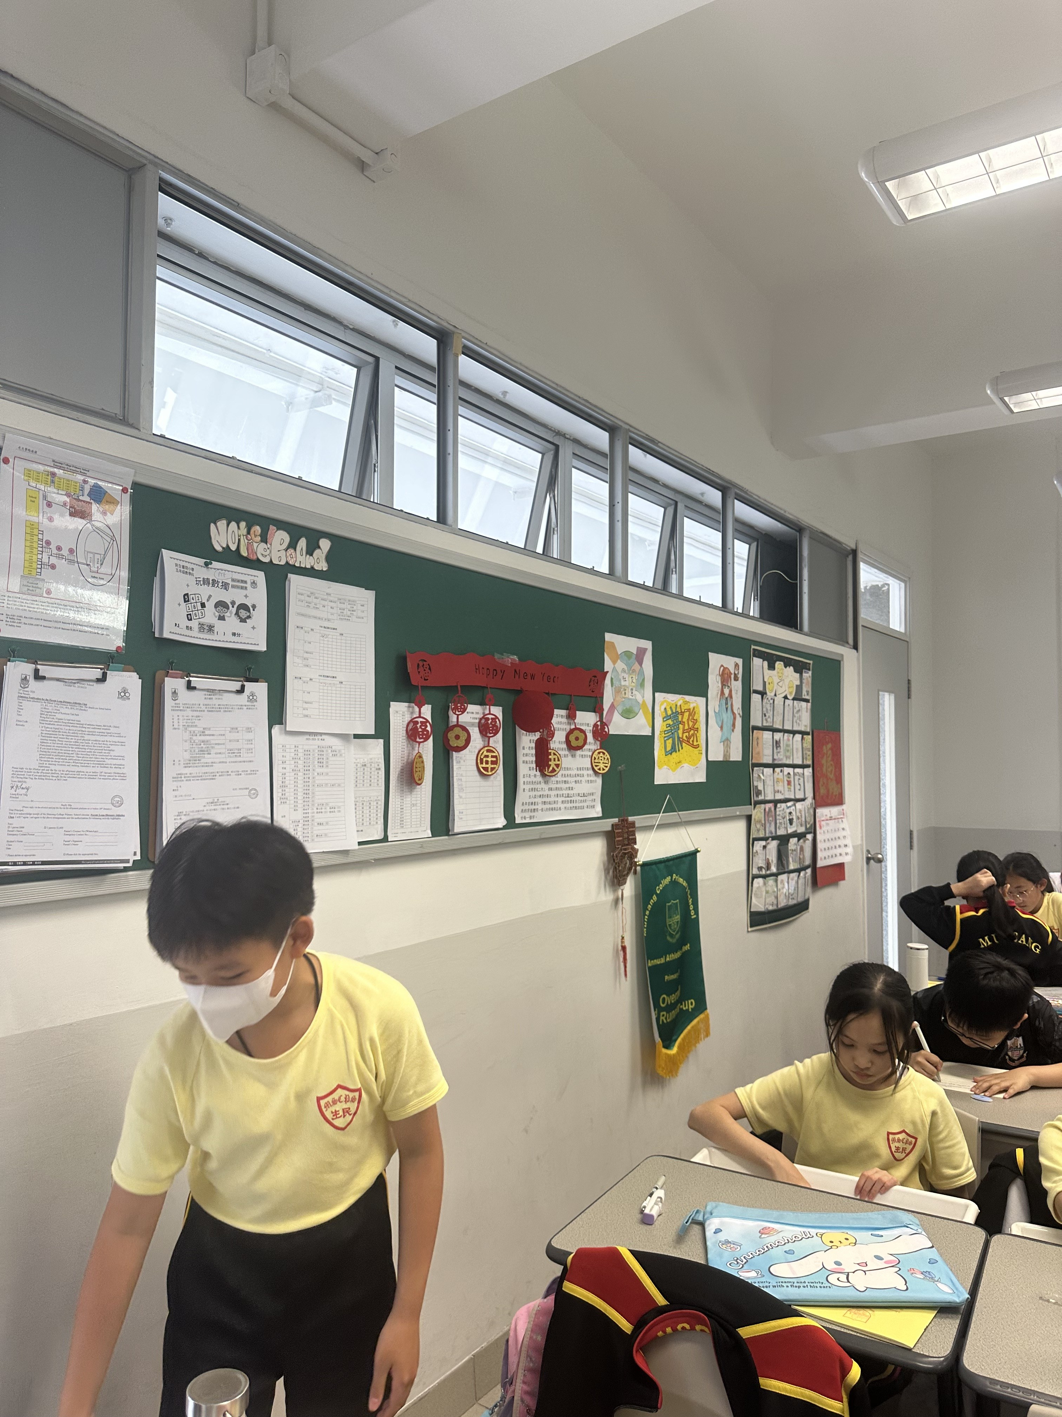
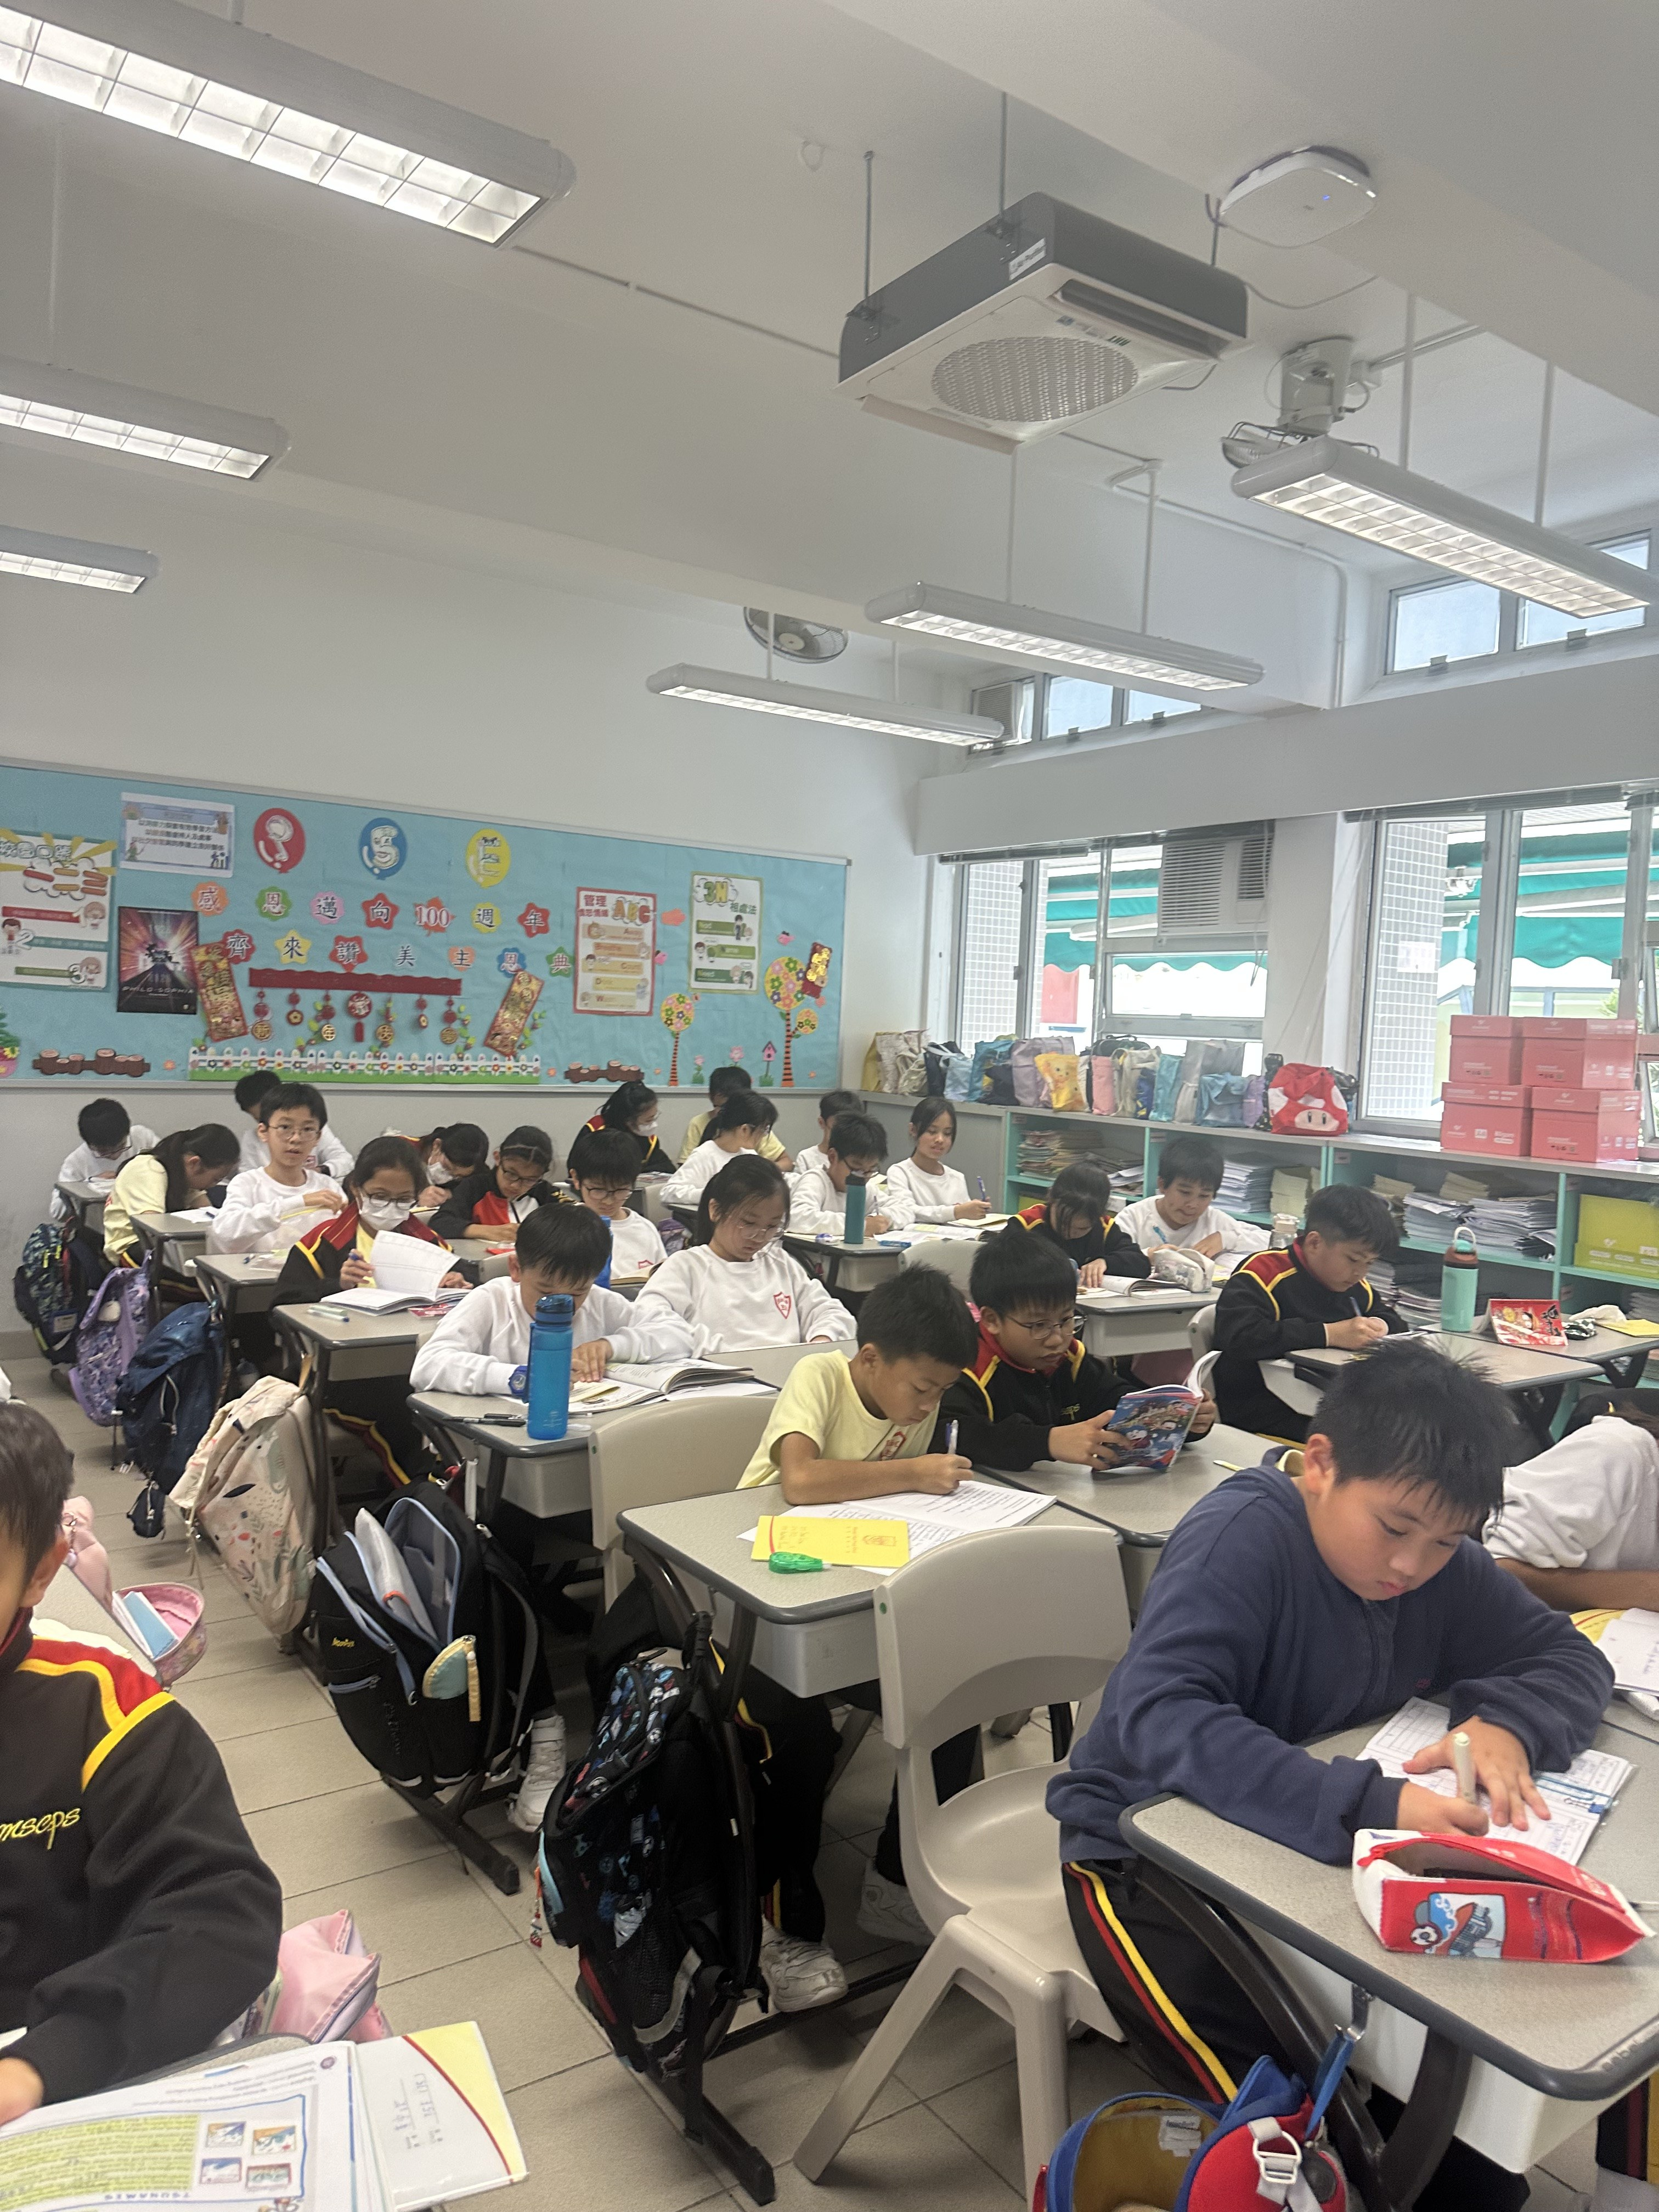
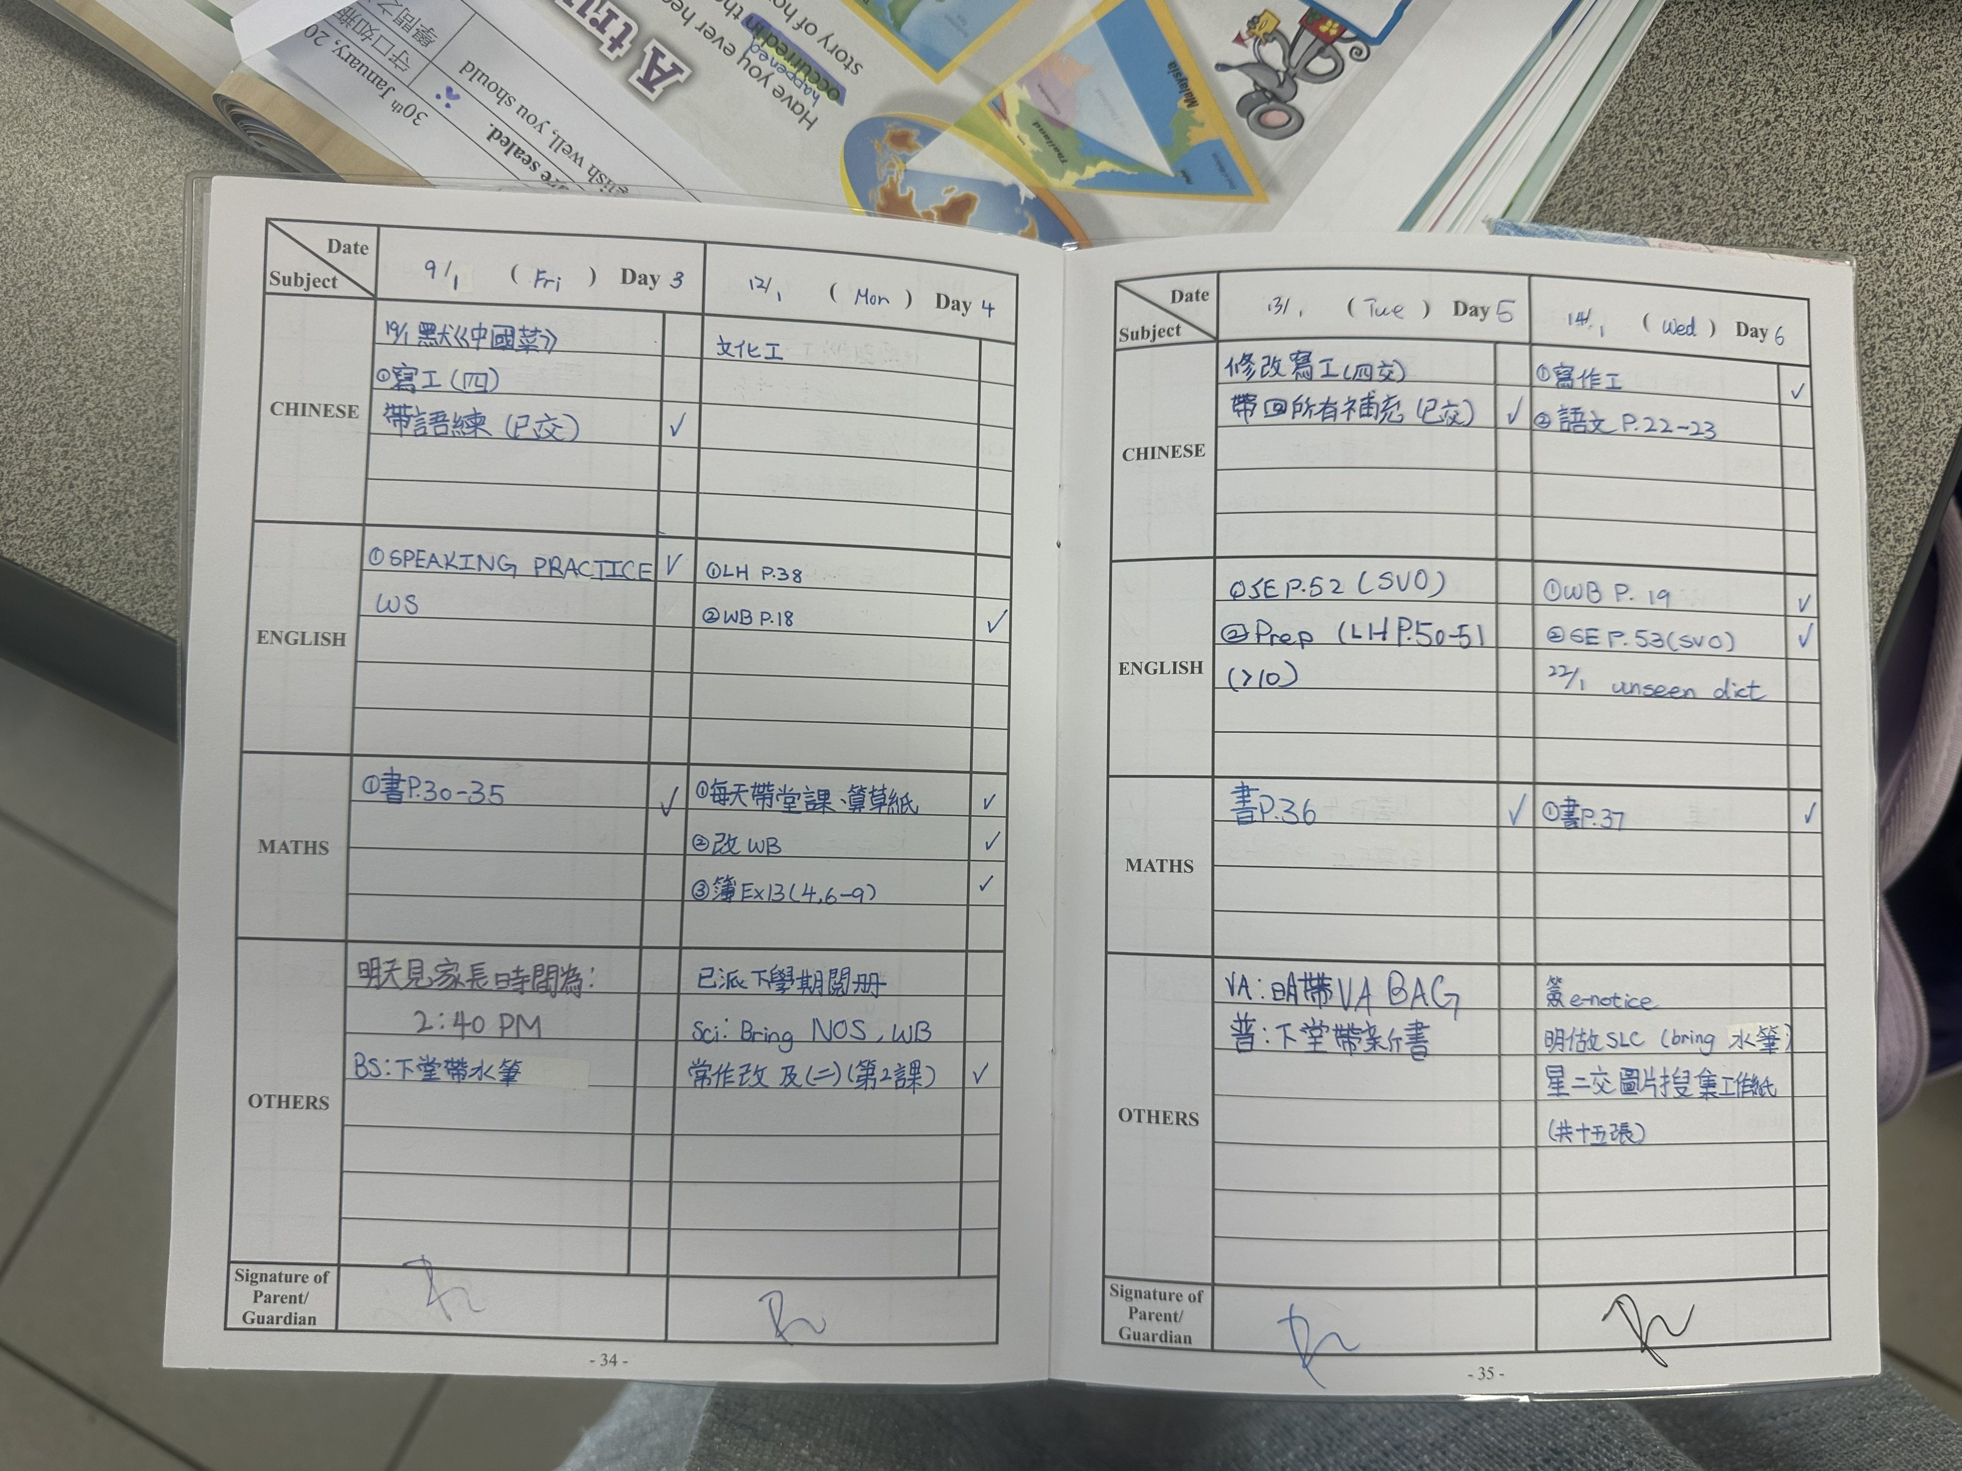
SERVICE IN ACTION · FIELD EVIDENCE
Four windows
into eight weeks of in-class life.
VALUES WALL
HOMEROOM CLIMATE
ABC anger-management + 3N relationship rules — moral exemplar role made visible.
Pupils transitioning between activities — care, focus and gentle structure coexist.
INDEPENDENT PRACTICE
HOME–SCHOOL HANDBOOK
Whole class working — quiet evidence of pedagogical environment design.
Differentiated daily assignments + parent counter-signature — partnership, in writing.
✔ Used with permission of the school, mentor and pupils' families. No copyright concerns apply.
11 / 14
Notes:
Four photographs from inside the classroom. The values wall — moral exemplar role made visible. The homeroom climate — care and structure coexist. Independent-practice — pedagogical environment design at work. And the home–school handbook — differentiated daily assignments with the parent's counter-signature, a partnership written down. Every photo is here with the explicit permission of the school, the mentor, and the pupils' families.

Slide 12
WHO I AM · THE WORKING ANSWER
Four roles, integrated.
One identity, declared.
01
02
03
04
KNOWLEDGE TRANSMITTER
MORAL EXEMPLAR
CARE-GIVER
DESIGNER OF LEARNING
of subject content
of values & conduct
of pastoral concern
ENVIRONMENTS
with care and accuracy
modelled, not preached
professionalised, not improvised
Bruner — pedagogy made visible
ANCHORED BY
Noddings' ethic of care (2005) — reflective, ethically complex, in service of every learner.
12 / 14
Notes:
So who am I, today, after eight weeks? Four roles integrated: knowledge transmitter with care and accuracy; moral exemplar — modelled, not preached; care-giver — professionalised, not improvised; and designer of learning environments — pedagogy made visible. All four anchored by Noddings' ethic of care: reflective, ethically complex, in service of every learner.

Slide 13
THREE COMMITMENTS · CLOSING THE GAP
What I will do next —
to become a Committed Role Model.
COMMITMENT 01
COMMITMENT 02
COMMITMENT 03
INITIATIVE
INTELLECTUAL HUMILITY
REFLECTIVE DISCIPLINE
Curriculum Leadership
PLC Contribution
Gibbs' Reflective Cycle
Join my subject panel during block practice — co-design materials & cross-disciplinary themes.
Design and facilitate a CPD sharing session on digital tools for differentiated instruction.
Weekly structured reflections + fortnightly mentor calibration.
→ Lesson-level → System-level (Marsh et al., 1990).
→ Pedagogical reasoning made visible (Hargreaves & O'Connor, 2018).
→ Anchored by EDB Guidelines (2022).
13 / 14
Notes:
Three concrete commitments before block practice. One: curriculum leadership through co-design with the subject panel — the move from lesson-level to system-level thinking. Two: facilitate a CPD session on digital tools for differentiated instruction — making my reasoning publicly visible and inviting critique. Three: weekly structured reflections via Gibbs' cycle plus fortnightly mentor calibration — turning experience into evidence-based learning, anchored by the EDB Guidelines.

Slide 14
CLOSING · MY MISSION IN ONE SENTENCE
Empower every student
to thrive as an empathetic,
critical-thinking
lifelong learner.
Thank you.
ZHENG AIYU · 11533739 · FE Foundation Course · 2026
14 / 14
Notes:
I'll close with my mission, in eleven words: empower every student to thrive as an empathetic, critical-thinking lifelong learner. That sentence will sit on every lesson plan I write next year, and on the CV I write the year after. Thank you. Questions are welcome.

